Slide 1
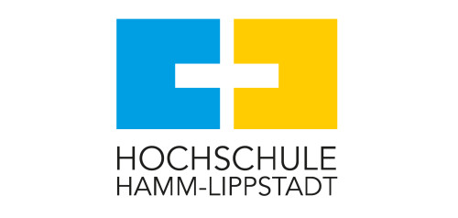
Symbolic Scheduling
Abu Sayem

Slide 2
Motivation
Modern embedded systems are complex and heterogeneous.
Software and hardware components must coordinate precisely.
Traditional scheduling methods struggle with:
Large design spaces
Nondeterministic behavior
Timing/resource constraints
Symbolic scheduling offers a more scalable, formal alternative.

Slide 3
Background of Scheduling
Traditional scheduling: enumerates all possible task orders
Slow and not scalable
Symbolic scheduling:
Uses logic formulas and constraints
Represents multiple behaviors compactly
Uses tools like SMT solvers, BDDs, and symbolic execution

Slide 4
Symbolic Scheduling Techniques
FunState Model (Strehl et al.)
Combines functional programming and state machines
Cabodi et al. Method
Uses Binary Decision Diagrams for symbolic scheduling and allocation
Soviani's Scheduling for Pipelines
Applies symbolic techniques in high-level synthesis for networking hardware

Slide 5
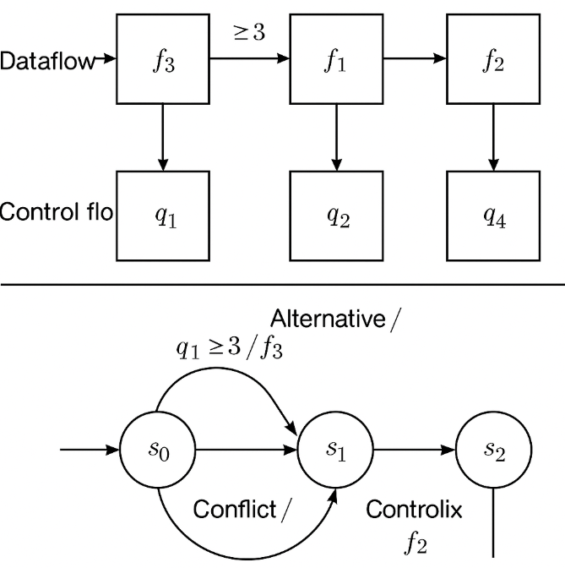
FunState Model
Combines state machines and functional programming
Models mixed data/control flow and nondeterminism
Produces deadlock-free, bounded schedules
Suited for early design stages in HW/SW co-design

Slide 6
Cabodi et al. Symbolic Allocation
Integrates scheduling with resource allocation
Uses Binary Decision Diagrams (BDDs) for symbolic representation
Optimizes control-intensive hardware designs
Highly scalable and suitable for large hardware systems

Slide 7
Soviani’s Method Symbolic Scheduling for Pipelines
Applied in high-level synthesis (HLS) for network accelerators
Focuses on pipelined hardware for packet processing
Improves performance and resource efficiency
Tailored to performance-critical, real-time applications

Slide 8
Which Works Best?
Method | Best Use Case | Strengths | Limitations
FunState | HW/SW Co-Design | Expressive, flexible | Less scalable
Cabodi | Hardware Synthesis | Scalable, optimized | Software modeling limited
Soviani | Real-Time Pipelines | High performance, domain fit | Narrow applicability
Different methods suit different contexts.
No universal solution.

Slide 9
Insights and Recommendations
FunState: Ideal for exploring and verifying early-stage HW/SW designs
Cabodi: Best for optimizing complex control-dominated hardware
Soviani: Targeted for pipelined, high-speed processing units
Hybrid approaches may combine strengths

Slide 10
Summary & Future Work
Symbolic scheduling helps manage complex hardware/software systems more efficiently. This presentation compared three key methods: FunState for flexible design, Cabodi’s method for scalable hardware synthesis, and Soviani’s approach for fast pipeline systems. Each works best in different situations.
In the future, these methods could be combined, improved with AI, and better integrated into real-world design tools.

